Slide 1
CGB1201 – JAVA PROGRAMMING PROJECT REVIEW-2
Department of Artificial Intelligence and Data Science
Academic Year: 2024 – 2025 (Odd Semester)
Register Number :2303811724321123
Name :VINO AGUSTIN V
Year :II
Semester :III
Section :B
Date :25/11/24

Slide 2
Title of the Project
AIRLINESRESERVATION SYSTEM

Slide 3
Abstract
An Airline Reservation System simplifies flight booking, ticketing, and passenger management. It enables users to search, book, and pay for flights while helping airlines manage schedules and reservations efficiently. This project aims to create a streamlined, user-friendly system to enhance travel convenience.

Slide 4
Introduction
An Airline Reservation System (ARS) is software that manages flight bookings, ticketing, and passenger information. It allows customers to search for flights, make reservations, and process payments online, while enabling airlines to update flight availability, handle cancellations, and manage schedules. The system often integrates with global distribution systems (GDS) to offer a wide range of flight options, improving operational efficiency and enhancing the customer experience.

Slide 5
Java Programming - Concepts Used
Classes and Objects:
Flight and Booking classes manage flight and booking details.
Encapsulation:
Attributes like flightNumber and availableSeats are encapsulated in their respective classes.
Collections:
HashMap stores flight details.
ArrayList manages bookings.
Control Structures:
Switch case for menu navigation.
For loops iterate through bookings and flights.
Input/Output:
Scanner reads user input.
System.out.println displays output.

Slide 6
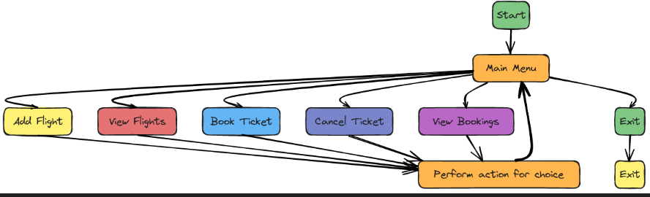
Proposed Architecture

Slide 7
Proposed Architecture - Description
Start: The entry point of the system.
Main Menu: After starting, users arrive at the Main Menu, where they can choose from several options related to flight management.
Options Available:
Add Flight (Yellow): Users can add new flight details to the system.
View Flights (Red): This option allows users to see available flights.
Book Ticket (Blue): Users can select and book tickets for flights.
Cancel Ticket (Light Blue): This allows users to cancel previously booked tickets.
View Bookings (Purple): Users can review their existing bookings.
Perform Action for Choice (Orange): After selecting an option from the Main Menu, users are directed to perform the corresponding action based on their choice.
Exit (Green): Users can exit the system at any time, either from the Main Menu or directly from any action page.

Slide 8
List of Modules
Flight Management Module
Booking Management Module
User Interaction Module
Data Management Module

Slide 9
Module Description
Flight Management Module
Handles all aspects of flight operations, including scheduling, flight status updates, aircraft details, crew assignments, and compliance with regulations.
Booking Management Module
Manages flight reservations, ticketing, payment processing, booking changes, customer notifications, and integration with loyalty programs.

Slide 10
Module Description (Cont..)
User Interaction Module
Facilitates communication between users and the system through an intuitive interface, handling user queries, feedback, and interactions for seamless navigation and task completion.
Data Management Module
Handles the storage, retrieval, and organization of data, ensuring data integrity, security, and accessibility for all system modules.

Slide 11
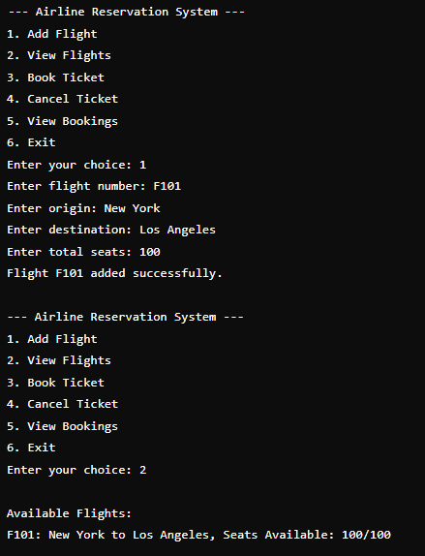
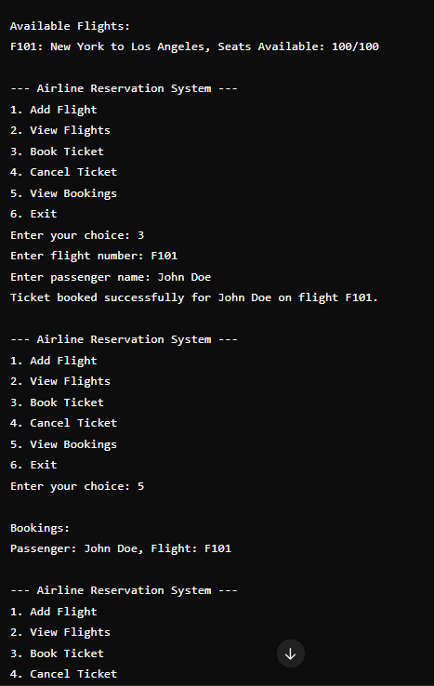
Results and Discussion

Slide 12
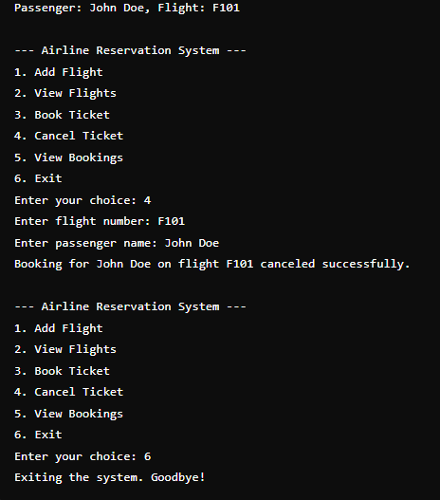
Results and Discussion (Cont..)

Slide 13
Conclusion
In conclusion, the airline reservation system integrates modules like flight management, booking management, user interaction, and data management to deliver a streamlined and efficient experience. It ensures seamless operations, simplifies the booking process, enhances customer satisfaction, and maintains secure and organized data handling. This system is essential for modernizing airline services and meeting the needs of passengers and operational staff effectively.

Slide 14
Thank You
Any queries???

